Slide 1



Organisational Structures
PROJECT MANAGMENT
PRESENTED BY
DYOVAN MADHAV
MDB23024
PRESENTED TO
DR RUDRA RAMESHWAR

Slide 2

OBJECTIVES
1. Definition of Organisational structures.
2. Types of Organisational structures
3. Advantages and Disadvantages
4. Real life cases

Slide 3

Organisational Structure
Organizational structures refer to the way in which an organization arranges its lines of authority, communications, rights, and duties.
Each structure has its own advantages and disadvantages based on the organization's size, goals, culture, and industry.

Slide 4

TYPES OF ORGANISATION STRUCTURES AND ITS ADVANTAGES AND DISADVANTAGES

Slide 5

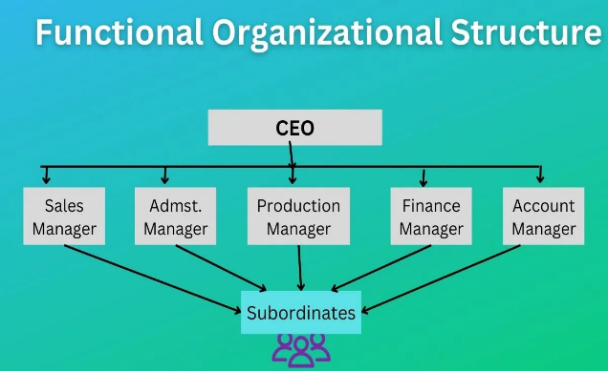
Functional Structure
In functional organizational structure employees are organised based on specialized functions or roles they perform within the organization.
In this structure, departments are formed based on functions such as marketing, finance, operations, human resources, etc.

Slide 6
Functional Structure
Advantages
Efficiency
Clear Career Paths
Ease of Control and Coordination
Specialization and Expertise
Disadvantages
Communication Barriers
Slow Decision-making
Limited Understanding
Resistance to Change

Slide 7

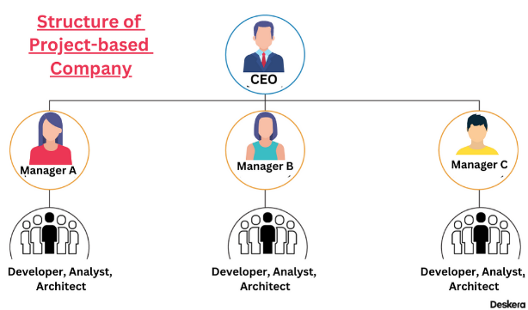
Project based Structure
A project-based organizational structure is where teams are formed specifically for projects and disbanded once the project is completed.

Slide 8
Project based Structure
Advantages
Opportunity
Equality
Appraisals
Flexibility
Disadvantages
Isolation from other teams
career continuity and professional growth
knowledge transfer

Slide 9

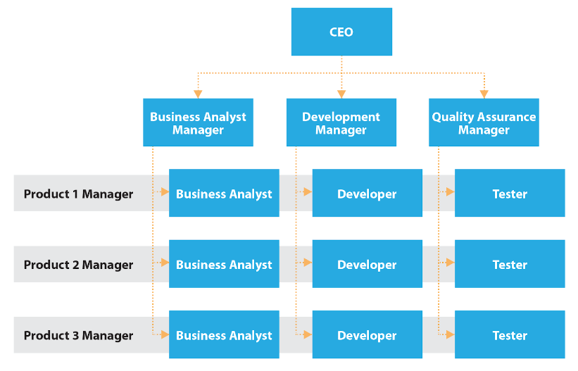
Matrix Structure
.
The matrix organizational structure is a hybrid model that combines elements of both functional and project structures.
In this setup, employees have dual reporting relationships - they report both to functional managers and project managers .

Slide 10
Matrix Structure
.
Advantages
Efficient Resource Utilization
Flexibility
Enhanced Communication
Adaptability
Disadvantages
Conflict and Power Struggles
Complexity
Time-Consuming
Potential for Stress and Burnout

Slide 11

Other types
Flat Structure
Divisional Structure
Network Structure
Team-Based Structure

Slide 12




Real World Examples
Google : Known for its matrix-like structure fostering innovation.
Amazon : Utilizes a functional structure, adapting as it expands into various industries.
Zappos : Emphasizes a flat structure to promote a culture of freedom and innovation.

Slide 13

Conclusion
Organizational structures are important because they help businesses implement efficient decision-making processes.
By assigning specialized roles to lower-level employees, businesses can make better decisions faster

Slide 14

Reference
https://penpoin.com/project-based-organizational-structure
https://www.wikipedia.org/
https://www.investopedia.com

Slide 15

Thank You
Dyovan Madhav
dyovankoroth@gmail.com
+91 9544357424
http://www.linkedin.com/in/dyovan-madhav

